Slide 1

Orientation for New Hires
Product Managers and Sales Representatives

Slide 2



New Hire Orientation
Please make a selection.

Slide 3
ORGANIZATION

Slide 4
Managerial Team
Simon Lodine, PhD
CEO
Jason Hemlock, PE
Principal Design Engineer
June-Su Woo, JD
Legal Counsel
Reggie Tupp
Admin Assistant
Sally Kerner, MBA
CFO
Robert Molina
Lead Solar Installation Technician
Jodean Langford
VP Sales & Marketing
Josephine Blickman, PhD
VP Engineering & Manufacturing
Charles Woodwick, MA
VP Human Resources
Joshua Delroy, CPA
Accountant
Lisa Marlee,
Senior Sales Representative
Ray Nguyen
Sales Representative
Evelyn Dott, MBA
Manufacturing & Distribution Manager
Rodney Tilden
Warehouse Supervisor

Slide 5
Employees By Facility

Slide 6
HQ Employee Roles
Role | Primary Responsibilities
Administrative Assistant | Answer phone, gatekeeper to executives, manage schedule
Marketing Specialist | Write press releases, organize events, serve as media contact
Product Manager | Manage individual product development from cradle to grave
Sales Representative | Manage enterprise sales accounts and client relations
Social Networking Specialist | Maintain Facebook, Twitter, LinkedIn, and YouTube accounts
Product Engineer | Manage development of products from cradle to grave
Product Technician | Write installation manuals and specification sheets
Legal Counsel | Provide legal advice and support for all Headquarters activities
IT Technician | Maintain website, server, and all computer systems

Slide 7
PRODUCTS

Slide 8
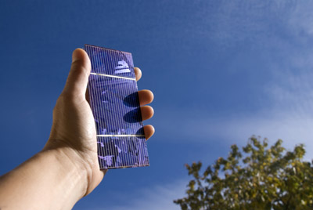
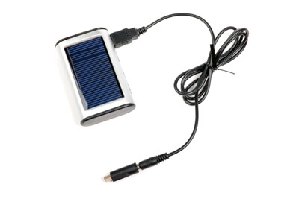

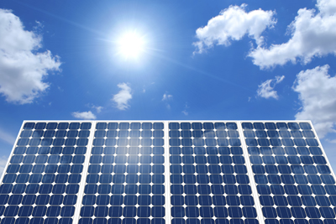
Top Selling Solar Products
K-Eco Mini Panel
K-Eco Phone Charger
K-Eco Energy Bulb
K-Eco Solar Panel
Please make a selection.
Notes:
Before we got into wind power, and other alternative energy technologies, KinetEco started with solar power. And it’s this product line that catapulted us to the forefront of environmentally-conscious technologies, where we’ve remained the industry leader for nearly 20-years.

Slide 9

K-Eco Mini Panel
Tiny 4”x 3” size.
Provides up to 20 hours of power for mobile and gaming devices.
Only 6 to 8 hours to charge in partial to full sun.
Notes:
Take our K-Eco Mini Panel, for example.
This tiny solar panel is just 4”x 3” in size, yet, when fully charged...
It can provide up to 20 hours of power for portable music players, phones, and game consoles.
And, get this! It only takes 6 to 8 hours to charge COMPLETELY, in partial to full sun.

Slide 10
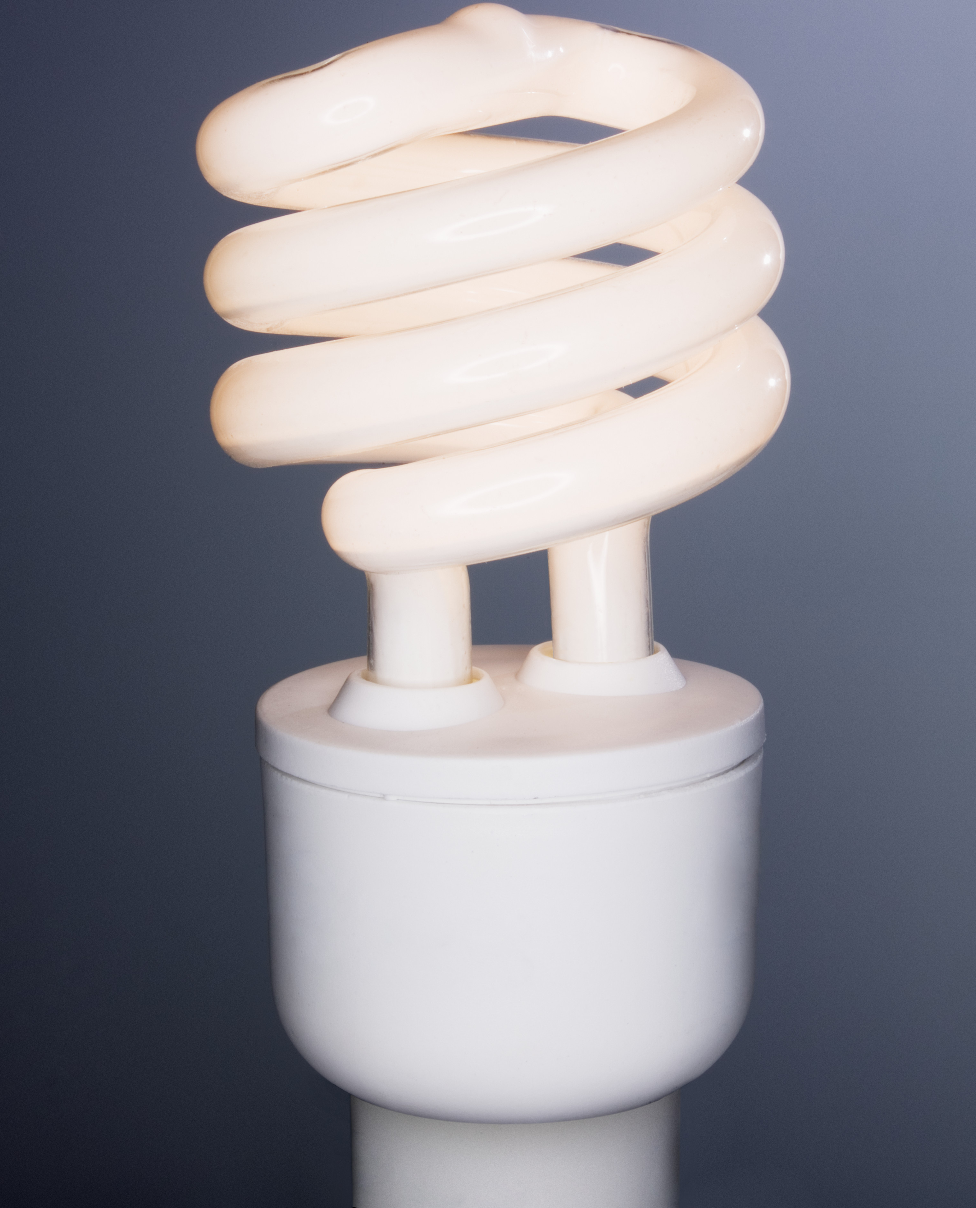
K-Eco Energy Bulb
CFL bulbs use 75% less energy.
CFL bulbs provide pure white light.
Available in a range from 9W to 70W.
Notes:
Our K-Eco Energy Bulbs might not seem as exciting as the solar charger, but when you hear that…
…these CFL bulbs use 75% less energy than incandescent bulbs, and they provide the SAME amount of light, I’m sure you’ll want to switch out ALL the bulbs in YOUR home!
Our CFL bulbs also provide the cleanest, most beautiful, white light I’ve personally ever seen from a light bulb. In fact, in over a dozen consumer surveys, our K-Eco bulbs consistently rank at the top for quality of light.
And, our bulbs are available in wattages from 9-Watts to 70-Watts. This means there’s a K-Eco bulb for every purpose in the home or office.

Slide 11
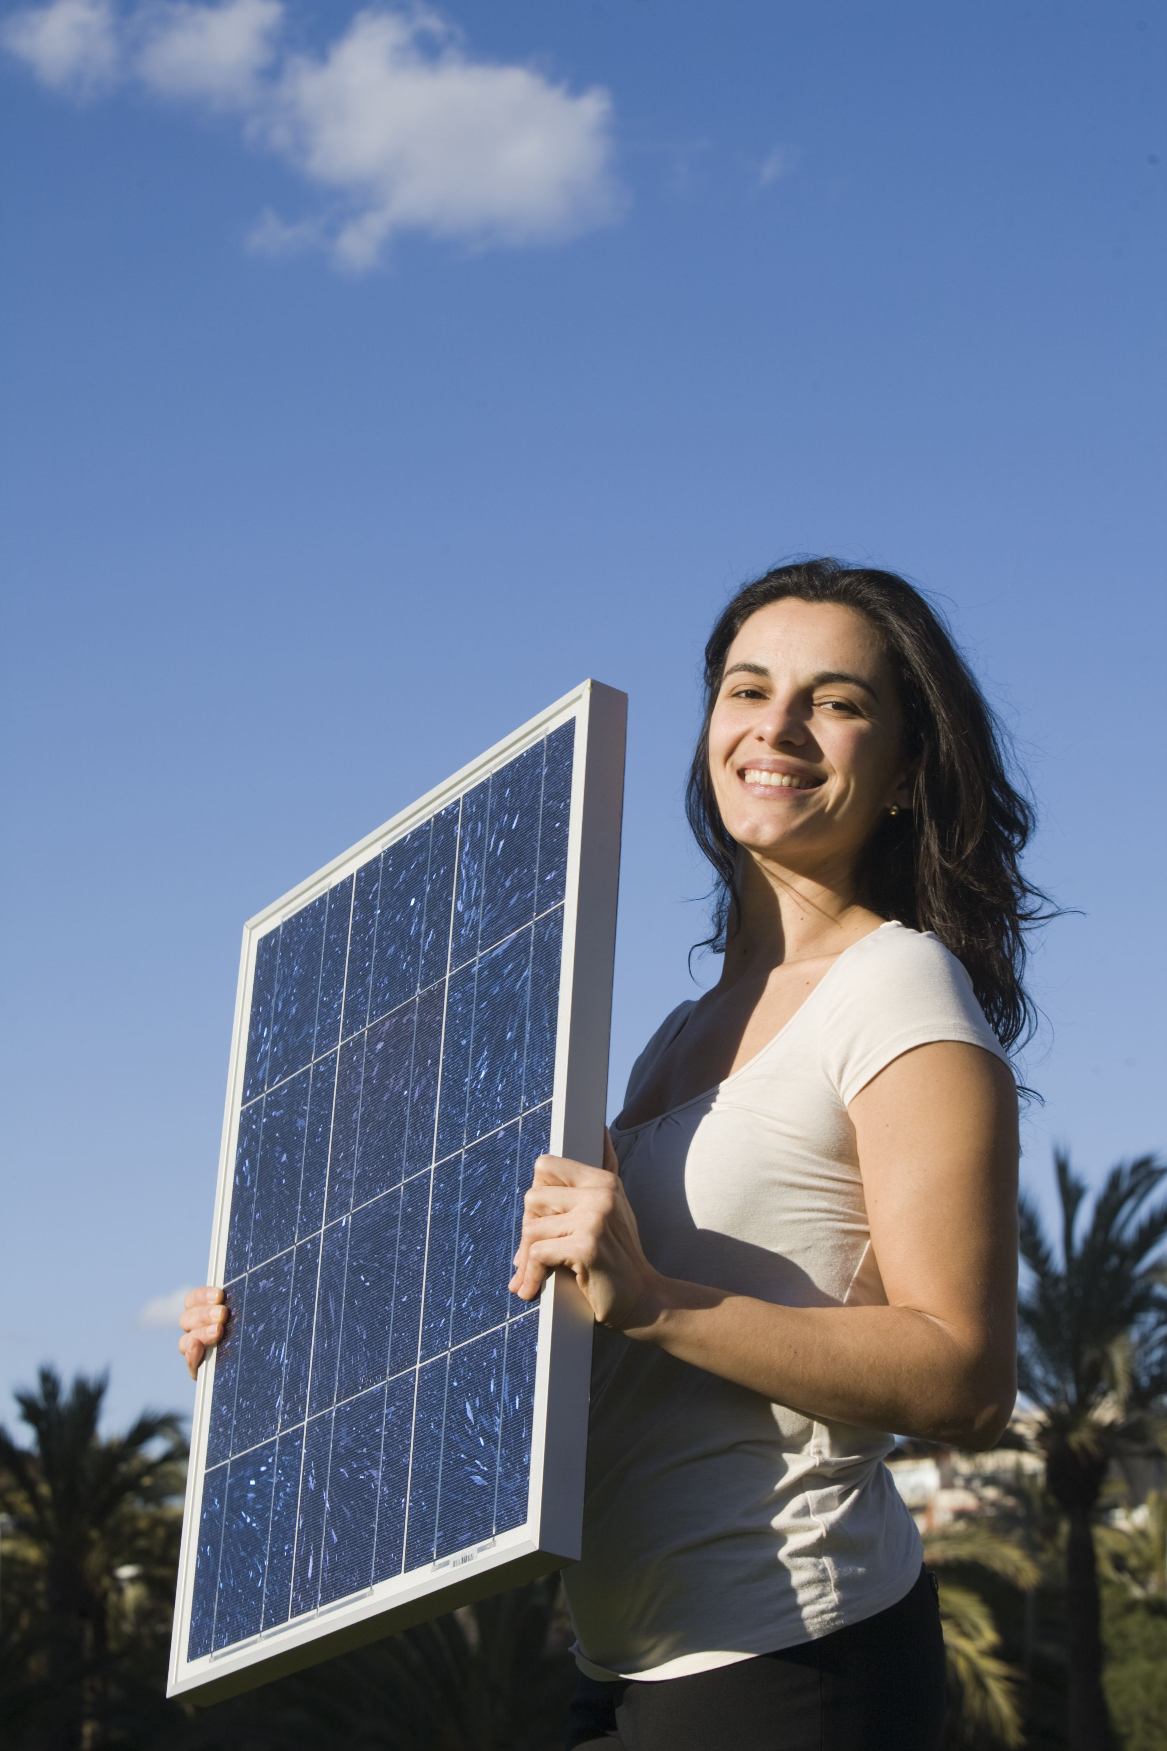
K-Eco Solar Panel
Highest energy output of any solar panel.
Highest efficiency in the smallest footprint.
Available in wide range of wattages from 180W to 230W.
Notes:
Now, let’s talk about our real energy-saver…the K-Eco Solar Panel.
First, it has the highest module efficiency of any solar panel on the market today. K-Eco solar panels convert nearly 20 percent of the energy from the sun that hits the panels, into usable energy in your home or office.
Next, it has the highest energy efficiency in the smallest footprint. K-Eco solar panels, on average, produce a generous 18 kW of power per square foot.
And, because we believe our customers should have lots of options, our K-Eco solar panels are available in a variety of energy ratings from 180-Watts to 230-Watts. That means we have panels for a wide range of applications and budgets.

Slide 12

K-Eco Phone Charger
Is completely portable.
Functions on a cloudy day.
Charges in only 2 hours.
Provides up to 18 hours of power.
Notes:
Rounding out our top-selling solar products, we have the K-Eco Solar Phone Charger.
This popular gadget fits in a pocket and is completely portable.
And, it even functions on a cloudy day! Our charger has a patented mini battery that holds a small charge reserve for extended cloud coverage. However, the panel itself will still pick up some charge from the sun, even during overcast days.
Also, the charger features our patented Rapid Solar Charge technology. That means the unit is fully charged after only 2 hours in full to partial sun.
And it keeps phones charged up to 18 hours a day!

Slide 13
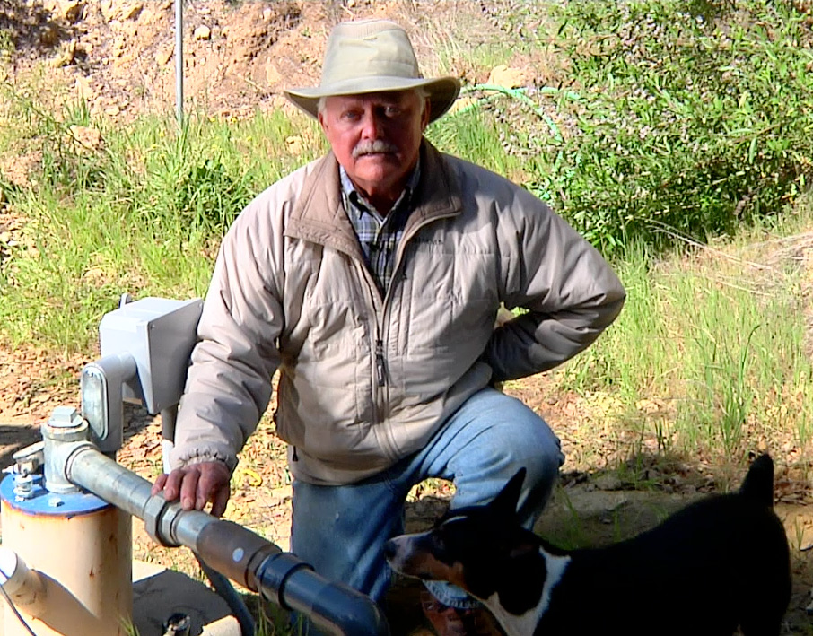
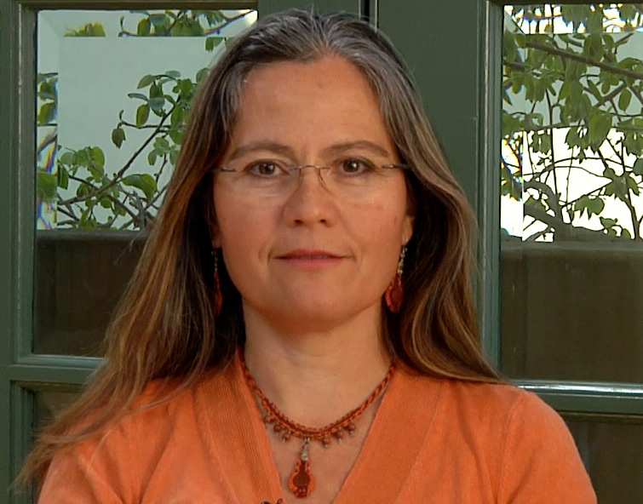
Testimonials
Cecilia, Sun Pacific Solar Electric
Ron, Farmer and Solar Customer
Click text or photo to play audio.
Notes:
Do NOT use .mp3 version of sound. Use .wav file.

Slide 14
MARKETING

Slide 15
Social Networking
Blog: www.blog.kineteco.net
Facebook: www.facebook.com/KinetEco
Twitter: www.twitter.com/KinetEco

Slide 16


Video PSA
Click to play video.

Slide 17
THANK YOU

